Slide 1
Enabling Technologies
Roland Lehner, Florian Grill, Mario Murrent

Slide 2
Used Technologies
OpenStack (DevStack)
.NET
NodeJs
Ubuntu 14.04.1

Slide 3
Interface Design
Client
CloudMarket Service
OpenStack

Slide 4
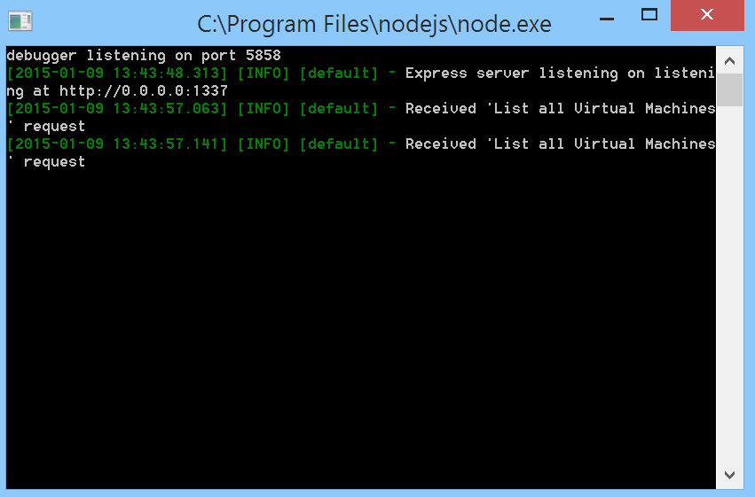
Implementation Detail - Service
CloudMarketService
REST based
NodeJS

Slide 5
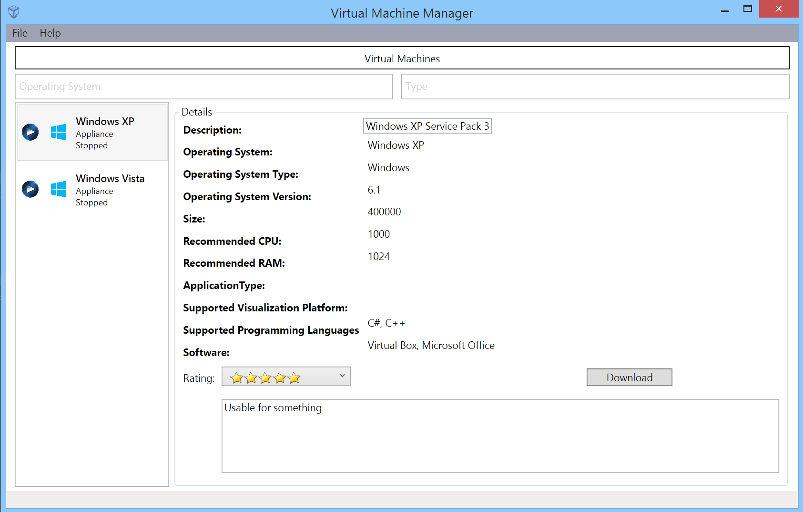
Implementation Detail - Client
.NET WPF Client

Slide 6
Message Pattern
REST Service
Request – Search for Virtual Machine or Appliance
http://localhost:1337/machine/all/Virt
JSON response
{ "Success":true, "ErrorMessage":"", "Data":[ { "Id":"3", "Name":"Windows XP", "Description":"Windows XP Service Pack 3", "Type":"Virtual Machine", "ApplicationType":"", "OperatingSystem":"Windows XP", "OperatingSystemType":"Windows", "OperatingSysteVersion":"6.1", "Size":"400000", "RecommendedCPU":"1000", "RecommendedRAM":"1024", "SupportedVirtualizationPlatform":"", "Software":[ ], "SupportedProgramingLanguages":[ ], "Rating":"", "RatingDescription":"", "Status":"Stopped" } ] }

Slide 7
Problems
Debian – not really supported
Documentation is confusing
Step by step guide for configuring Openstack is not working

Slide 8
Lessons Learned
Use DevStack for a single machine
Design suitable message format

Slide 9
DEMO

